Slide 1
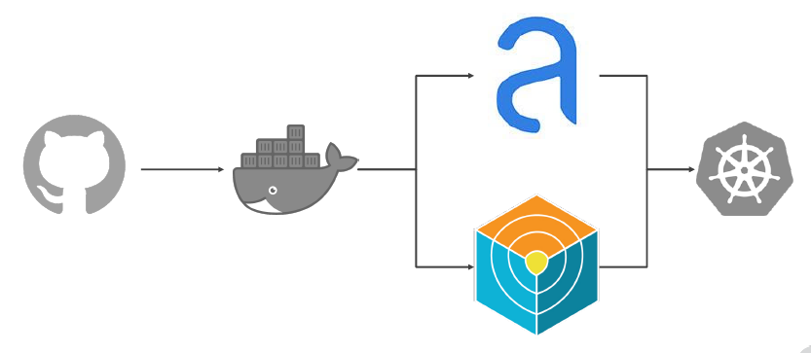
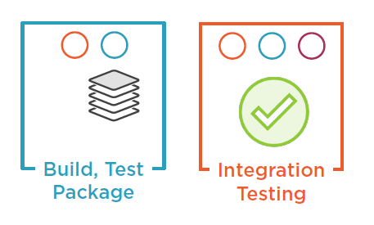
Images, Creation and Scanning
Build AGENT a.k.a Slave
Docker Image (=Build Server)
Dockerfile
Create
Image
Trivy
Push
Image
Scan
Image
Trivy
https://github.com/aquasecurity/trivy
OpenSource: Container Vulnerability Scanner
Binary, pulls Vulnerability DB, Scans Containers

Slide 2
Images, Creation and Scanning
Push
Image
Dockerfile
To Create Image
Trivy
Scan
Image
Trivy
https://github.com/aquasecurity/trivy
OpenSource: Container Vulnerability Scanner
Binary, pulls Vulnerability DB, Scans Containers

Slide 3
Images, Creation and Scanning
Build AGENT Docker Image (=Build Server)
https://github.com/aquasecurity/trivy
OpenSource: Container Vulnerability Scanner
Binary, pulls Vulnerability DB, Scans Containers
Shell
trivy <container to scan>
Pipeline (Windows Container/Host)
Requires: Windows Subsystem For Linux (WSL)
Pipeline (Linux Container/Host)
State(‘Run Trivy’)
Steps {
pwsh(script: “””
C:\\Windows\System32\wsl.exe
sudo trivy agent/dotnetcore
“””)
}
}
}
State(‘Run Trivy’)
Steps {
sh(script: “””
trivy agent/dotnetcore
“””)
}
}
}

Slide 4
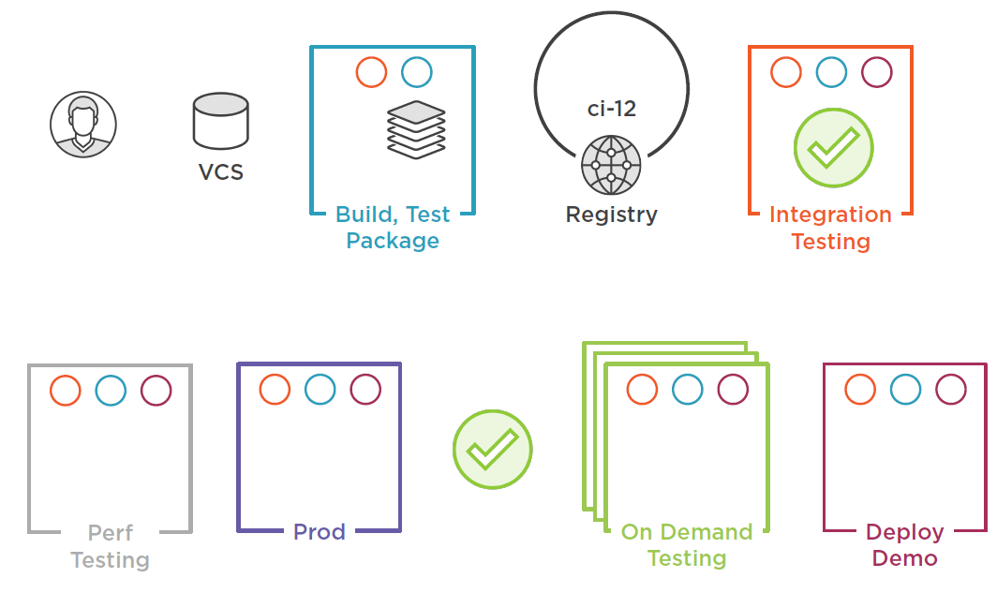
Build
Unit Tests
Create Image
-tag Image
-push Image
-Pull Tagged Image
-Run Tests
Check in code
Kicks off build
Run Software
- Run tests against
Out: Built Image
Pushed Image
Image Sources: https://app.pluralsight.com/library/courses/deployment-pipeline-aspdotnet-core-docker/table-of-contents
https://github.com/dotnet-architecture/eShopModernizing/wiki/04.-How-to-deploy-your-Windows-Containers-based-apps-into-Kubernetes-in-Azure-Container-Service-(Including-CI-CD)
Notes:
Image Sources: https://app.pluralsight.com/library/courses/deployment-pipeline-aspdotnet-core-docker/table-of-contents
Traditional: Use source code to create a Publish folder, used to run .NET on top of runtime. No Containers involved.
Containers: Host need not have any build prerequisites (Dumb build agents). Container deals with details. Prepackaged build containers.
Option to place published app in a container to run
Stages:
Check-in
Build, Test and Package in a container
Push to Registry – tagged with build number – keep older versions
Advanced Integrating testing
App Demo: End-To-End
API – Generates random names
MailHog SMPT Server – sends list of random names
Integration test runner – validates email was sent
SST Builds
MSVP Utilities
Deploy Latest version – On Demand
One-Many Demo or Testing (QA, Sales, Bug demonstrations, etc.) environments on-demand
Deploy to Production
Customized via configurations
Engine X as reverse proxy
Performance
Dynamic Analysis
Extending CI Capabilities – Adding Resources:
Deploy to Multiple Nodes – Docker Swarm
Kubernetes

Slide 5
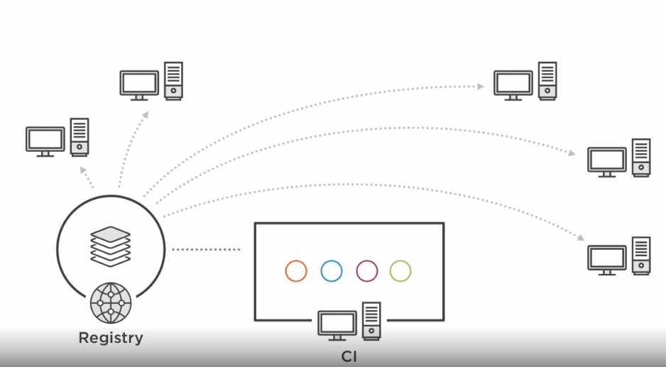
Simplest CI Infrastructure: Each running via Docker Container
Shared registry
CI Server (TeamCity, Jenkins works the same)
Image Sources: https://app.pluralsight.com/library/courses/deployment-pipeline-aspdotnet-core-docker/table-of-contents
https://github.com/dotnet-architecture/eShopModernizing/wiki/04.-How-to-deploy-your-Windows-Containers-based-apps-into-Kubernetes-in-Azure-Container-Service-(Including-CI-CD)
Notes:
Image Sources: https://app.pluralsight.com/library/courses/deployment-pipeline-aspdotnet-core-docker/table-of-contents

Slide 6
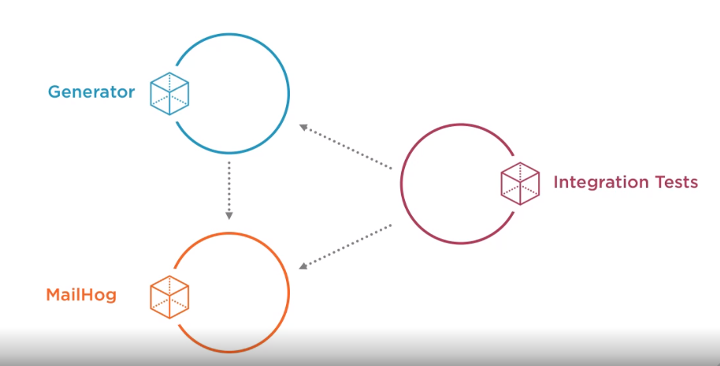
Image Source: https://app.pluralsight.com/library/courses/deployment-pipeline-aspdotnet-core-docker/table-of-contents
http://localhost:8080/swagger/
Generate Random Data API being tested
Unit tests and Dynamic Test
Email sent successfully?
Email contents validated
Random names present
Container
Generate
Email
Please
Send Email
SMTP Server
Container
Was it sent?
Did it contain expected content?
Container
http://localhost:8025/api/v2/messages
Image Sources: https://app.pluralsight.com/library/courses/deployment-pipeline-aspdotnet-core-docker/table-of-contents
https://github.com/dotnet-architecture/eShopModernizing/wiki/04.-How-to-deploy-your-Windows-Containers-based-apps-into-Kubernetes-in-Azure-Container-Service-(Including-CI-CD)
Notes:
.NET App
MailHog
Image Sources: https://app.pluralsight.com/library/courses/deployment-pipeline-aspdotnet-core-docker/table-of-contents

Slide 7
Build Test and Package
2
- Docker Compose File (generator-api)
# Build stage
FROM mcr.microsoft.com/dotnet/core/sdk:2.2 AS build-env
WORKDIR /generator
# restore
COPY api/api.csproj ./api/
RUN dotnet restore api/api.csproj
COPY tests/tests.csproj ./tests/
RUN dotnet restore tests/tests.csproj
# copy src
COPY . .
# test
RUN dotnet test tests/tests.csproj
# publish - note: will not occur unless test passes
RUN dotnet publish api/api.csproj -o /publish
# Runtime stage
FROM mcr.microsoft.com/dotnet/core/aspnet:2.2
COPY --from=build-env /publish /publish
WORKDIR /publish
ENTRYPOINT ["dotnet", "api.dll"]
Developing Project Docker File (generator-api\api)
1
Start Locally – create project, app, test suite. Make sure it works
Determine dependencies – packages, base Docker images etc.
Run via CMD line or IDE
Work out issues
Deploy Multi-Stage Image
> docker-compose up –d -build
# Build Stage
FROM microsoft/aspnetcore-build:2 AS build-env
WORKDIR /api
COPY api.csproj .
RUN dotnet restore
COPY . .
RUN dotnet publish -o /publish
# Runtime Image Stage
FROM microsoft/aspnetcore:2
WORKDIR /publish
COPY --from=build-env /publish .
ENTRYPOINT ["dotnet", "api.dll"]
Build
Tag
Run
> docker build .
> docker build -t testing .
> docker run --rm -it -p 8080:80 testing
Notes:
Create application (REST WebAPI Controller), then tie Build and tests together for CI
Write app and test code using language specific tools (again .NET in this case). Run it locally.
Add a dockerFile to build the application image
Tag that dockerFile so it can be recalled and used via CI
Create a docker-compose file to tie automation together:
Run REST image (slide 4)
Start MailHog server (SMTP so REST can actually send an email)
Run integration tests

Slide 8
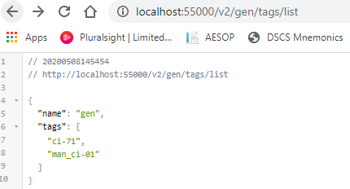
Tag Build
>>> Local Docker Images
docker build -t "localhost:55000/gen:man_ci-01" --no-cache .
^^ repo alias:tag^^
Push to Registry
>>> Hosted Registry
docker push localhost:55000/gen:man_ci-01
Registry website:
http:// localhost:55000/v2/_catalog
http://localhost:55000/v2/gen/tags/list

Slide 9
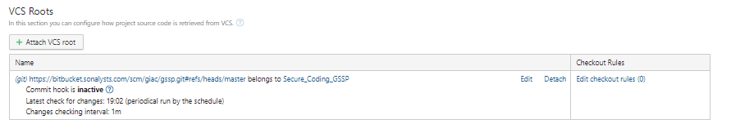
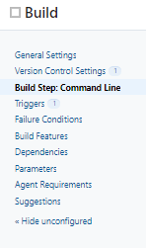
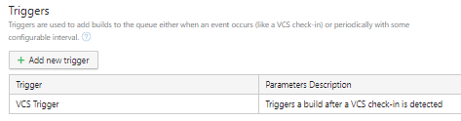
CI Server – Attach build with Repository
Web Hook – Sonalysts Bitbucket
Build Steps – Build & Test code, Tag & Push Image to Registry
image="localhost:55000/gen:ci-%build.number%"
docker build -t $image --no-cache .
docker push $image
triggered when branch changes

Slide 10
Integration Testing
separate project to request from REST, test receipt by Mailhog
1
Developing Integration Test Project:
3
Create integration test image… for reuse
> Mkdir ./integrations
> dotnet add package …
> dotnet new xunit
Write testd code
> dotnet restore
> dotnet build
> dotnet test
Create
Build Run
Tag Image
Run Image
docker build –t localhost:55000/gen:integration-10 .
docker run --rm –it localhost:55000/gen:integration-10
4
- Docker Compose File /integration/docker-compse.yml
services:
generator:
image: localhost:55000/gen:man_ci-01
ports:
- "8080:80"
mail:
image: mailhog/mailhog
ports:
- "8025:8025"
integration:
image: localhost:55000/gen:integration-10
build: .
2
Developing Project Docker File: /integration/dockerfile
FROM microsoft/dotnet:2-sdk
WORKDIR /integration
COPY integration.csproj .
RUN dotnet restore
COPY . .
ENTRYPOINT ["dotnet", "test"]
Build Multi-stage Image
Deploy Multi-Stage Image
docker-compose up buld
docker-compose up –d
Build Image
MailHog: http://localhost:8025/api/v2/messages
Generator API: http://localhost:8080/swagger
docker build .
Notes:
Create Integration application, then tie Build, Infrastructure (Mailhog) and Integration tests together for CI
Write integration tests and use language specific tools (again .NET in this case)
Add a dockerFile to create a integration test image that can be run… Note: not being built every time for efficiency
Tag that dockerFile so it can be recalled and used via CI
Create a docker-compose file to tie automation together:
Run REST image (slide 4)
Start MailHog server (SMTP so REST can actually send an email)
Run integration tests

Slide 11
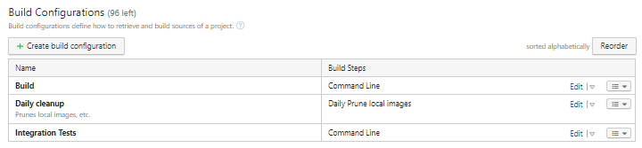
CI Server – Add Integration stage
Build & Test code, Tag & Push Image to Registry
Pull Tag, Run code, Run tests against running app

Slide 12
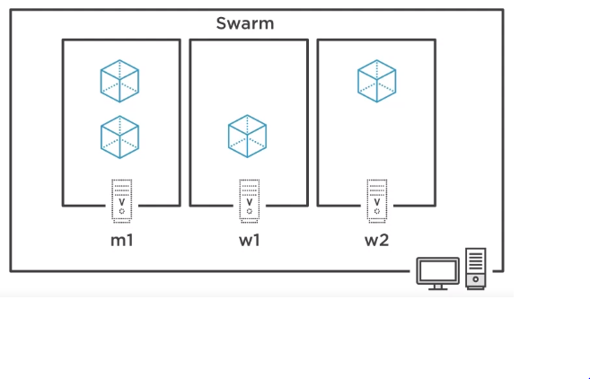
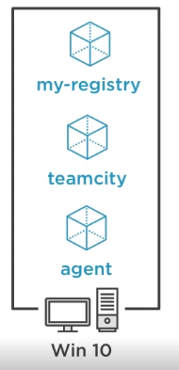
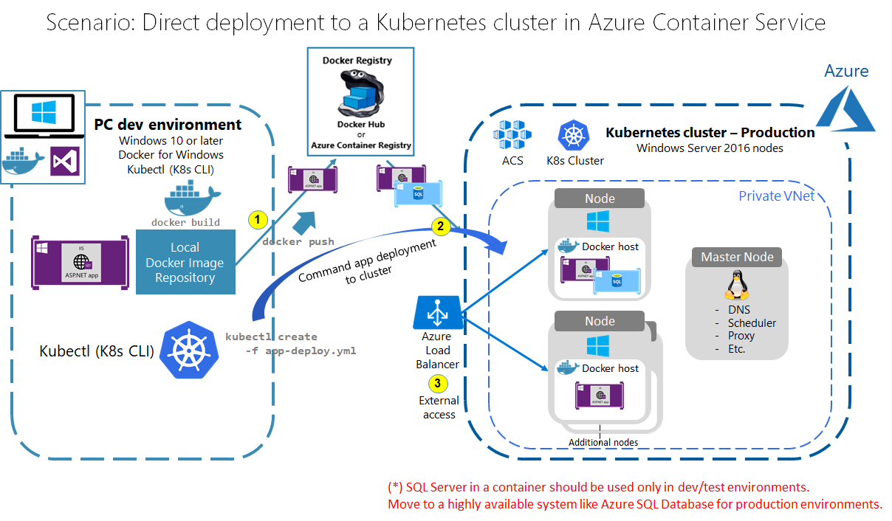
Deploy, On Demand Testing, Production Deployment - Options
Button push
N Environments, selectable
Docker Swarm
Local Deployment
Clusters
Kubernetes
Image Sources: https://app.pluralsight.com/library/courses/deployment-pipeline-aspdotnet-core-docker/table-of-contents
https://github.com/dotnet-architecture/eShopModernizing/wiki/04.-How-to-deploy-your-Windows-Containers-based-apps-into-Kubernetes-in-Azure-Container-Service-(Including-CI-CD)
Notes:
Image Sources: https://app.pluralsight.com/library/courses/deployment-pipeline-aspdotnet-core-docker/table-of-contents
https://github.com/dotnet-architecture/eShopModernizing/wiki/04.-How-to-deploy-your-Windows-Containers-based-apps-into-Kubernetes-in-Azure-Container-Service-(Including-CI-CD)

Slide 13
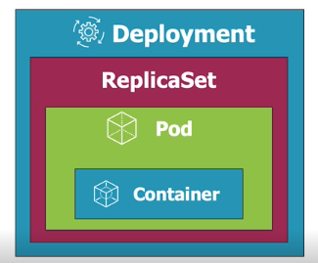
Deploy via Kubernetes Zero-downtime Deployment
Options / Techniques
Deploy local (dev box) or networked clusters (multiple resources)
Rolling Updates – deploy new and roll back versions – avoid duplication of services which can eat up resources unnecessarily
Canary – roll out new code to subset of users
Blue-Green Deployments – roll out multiple versions, control accessible – i.e. provide access for tester/dev 1 to app A, 2 to B, etc.
Rollbacks – kubernetes remembers previous deployments
Running Jobs and CronJobs
Performance Monitoring and Troubleshooting

Slide 14
CLI Deploy via Kubernetes Deployment IaC
# Create something new, expect errors when existing
kubectl create –f .\api.service.yml --save-config
Or
# Create if not exist, otherwise update existing
kubectl apply –f .\api.service.yml
apiVersion: apps/v1
kind: Deployment
metadata:
name: name-gen-api
labels:
app: name-gen-api
spec:
replicas: 3
selector:
matchLabels:
app: name-gen-api
template:
metadata:
labels:
app: name-gen-api
spec:
containers:
- name: name-gen-api
image: aspnetcore/generator:multi
ports:
- containerPort: 80
resources:
limits:
memory: "128Mi" #128 MB
cpu: "200m" #200 millicpu (20% cpu)
> …\aspnetcore-generator-api\api> kubectl get deployment
NAME READY UP-TO-DATE AVAILABLE AGE
name-gen-api 3/3 3 3 77m
> …\aspnetcore-generator-api\api> kubectl get replicaset
NAME DESIRED CURRENT READY AGE
name-gen-api-6d5c9cf6c 0 0 0 63m
name-gen-api-d5f885787 3 3 3 32m
> PS …\aspnetcore-generator-api\api> kubectl get pods
NAME READY STATUS RESTARTS AGE
name-gen-api-6d5c9cf6c-zplqz 0/1 Terminating 0 31m
name-gen-api-d5f885787-8d5h6 1/1 Running 0 12s
name-gen-api-d5f885787-8kns8 1/1 Running 0 11s
name-gen-api-d5f885787-fpgzq 1/1 Running 0 14s

Slide 15
CLI Deploy via Kubernetes Service IaC Example
Provide access, forward ports to API
# Create something new, expect errors when existing
kubectl create –f .\api.service.yml --save-config
Or
# Create if not exist, otherwise update existing
kubectl apply –f .\api.service.yml
apiVersion: v1
kind: Service
metadata:
name: name-gen-api
labels:
app: name-gen-api
spec:
ports:
- port: 80
targetPort: 80
selector:
app: name-gen-api
> …\aspnetcore-generator-api\api> kubectl get replicaset
NAME DESIRED CURRENT READY AGE
name-gen-api-6d5c9cf6c 0 0 0 63m
name-gen-api-d5f885787 3 3 3 32m
> PS …\aspnetcore-generator-api\api> kubectl get pods
NAME READY STATUS RESTARTS AGE
name-gen-api-6d5c9cf6c-zplqz 0/1 Terminating 0 31m
name-gen-api-d5f885787-8d5h6 1/1 Running 0 12s
name-gen-api-d5f885787-8kns8 1/1 Running 0 11s
name-gen-api-d5f885787-fpgzq 1/1 Running 0 14s
# Change redis-master-765d459796-258hz to the name of the Pod
kubectl port-forward name-gen-api-d5f885787-8d5h6 8080:80

